Slide 1
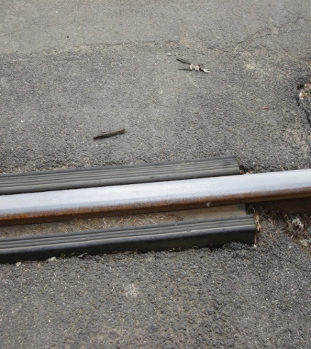
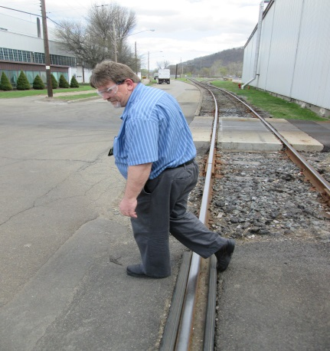
HS&E INCIDENT BULLETIN |  | 1st half year 2014
U.S. | Type of incident - Slip/Trip/Fall from same level
Summary:
A shop employee was crossing the rail road tracks between shops. As he crossed, he caught his foot on a section of the track causing him to lose his balance and fall. He extended his arms to catch himself and landed on his left arm/wrist resulting in injury to his wrist. Upon evaluation it was found the employee had a broken wrist and would require surgery to his wrist to ensure full use upon recovery.
Root Causes: | Actions Taken Thus Far: Next Steps
Uneven walking surface, inattention to footing and surroundings | Repair/pave uneven surface to remove the trip hazard, paint warning messages on pavement

